Slide 1
802.15.4 Project
The Northernites
Sam Weismuller, SangRyul “Eric” Pae, Jay Cordaro
MAS 2023 Students UC San Diego

Slide 2
802.15.4 Project RF Front End

Slide 3

RF Frontend + Mixed signal parts list

Slide 4
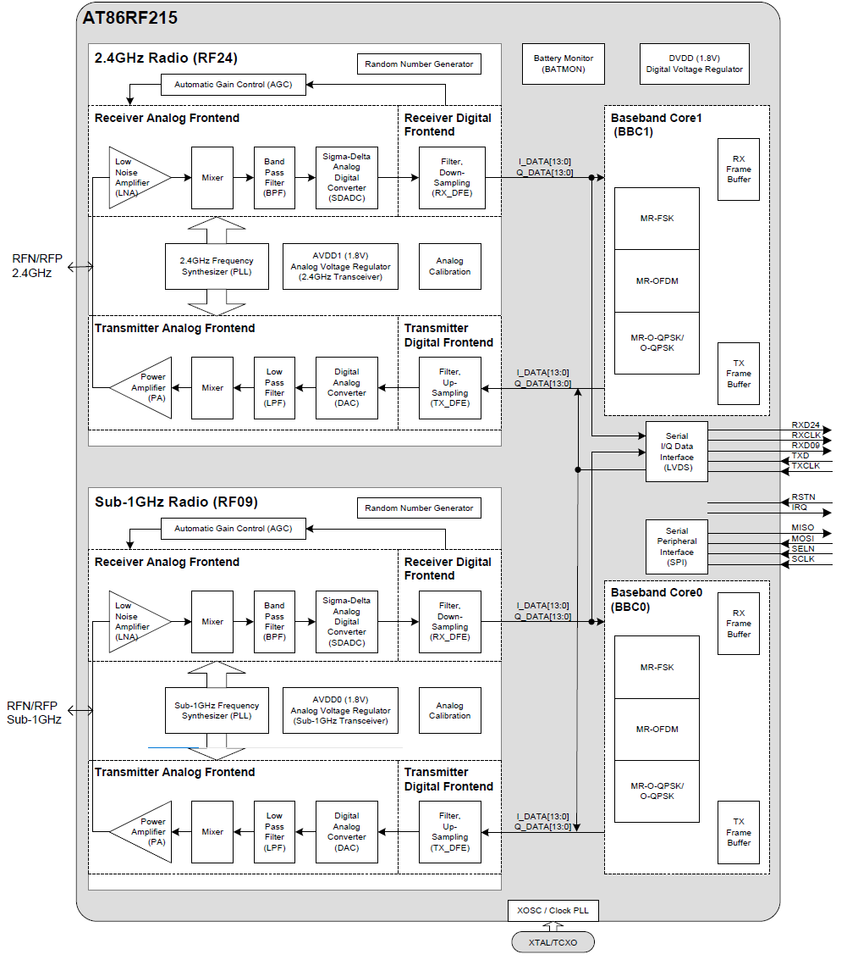
Block Diagram

Slide 5
RX

Slide 6
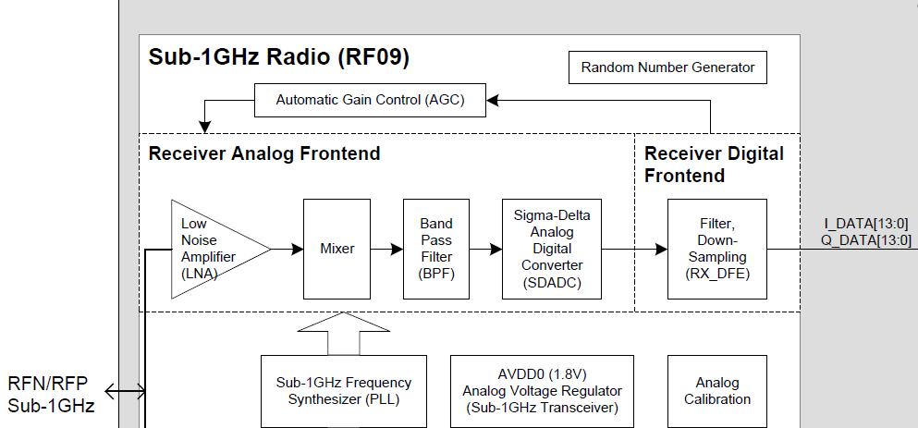

Slide 7
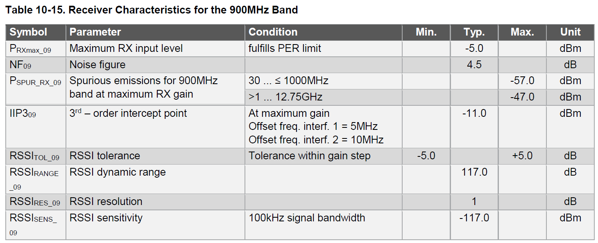
Rx RF BPF

Slide 8
<Required Eb/No (Energy per bit to Noise power density ratio) of the AT86RF215 transceiver >
: Packet Error Rate (PER) of less than 10% in MR-O-QPSK mode with a PSDU length of 20 octets, a PSDU data rate of 50 kbps and a 200 kHz chip rate
Bit rate = PSDU data rate / (8 x PSDU length)
= 50 kbps / (8 x 20) = 31.25 bps
Required BER to achieve PER < 10%:
BER = (PER / PSDU length)
= (0.1 / 20) = 0.005
By formula Eb/No = (Bit rate / Chip rate) x (log2(M) / BER),
Eb/No = (31.25 bps / 200 kHz) x (log2(4) / 0.005)
= 24.14 dB

Slide 9
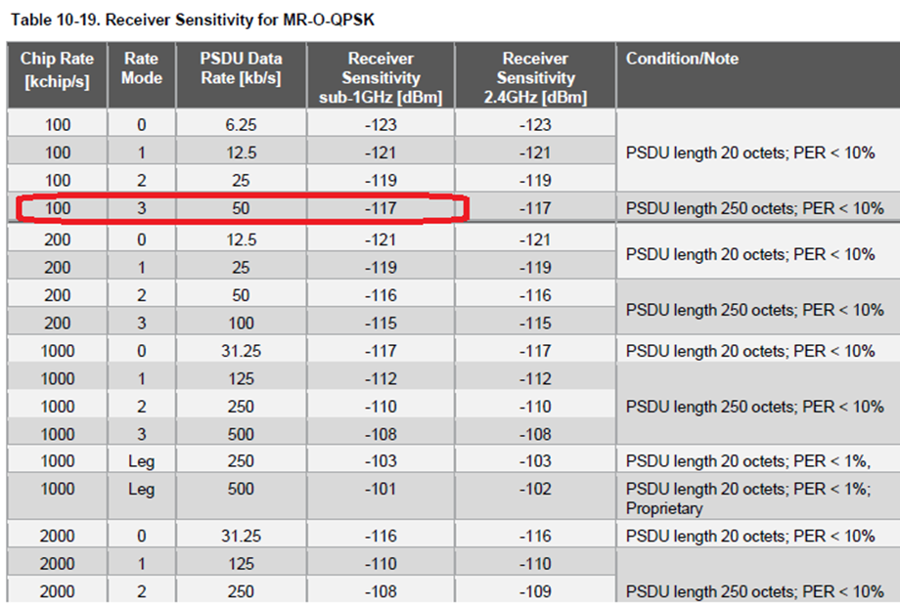
Reference sensitivity of AT86RF215

Slide 10
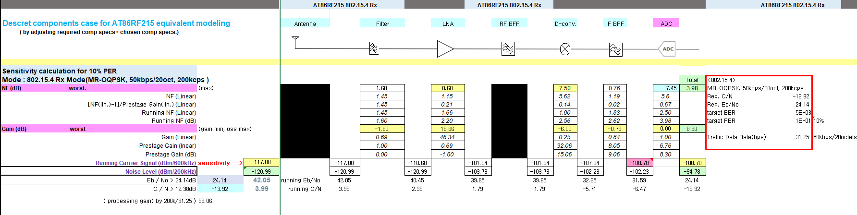
Discrete components case for AT86RF215 equivalent modeling
( by adjusting required comp specs+ chosen comp specs.)

Slide 11
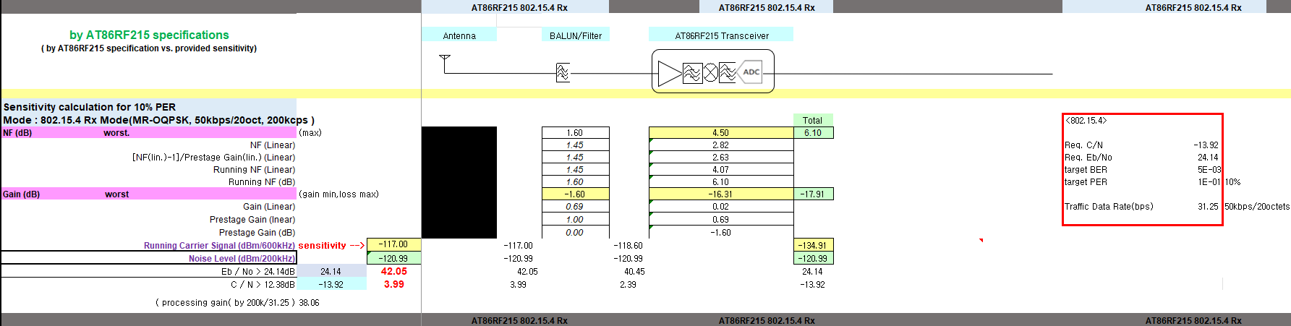
By AT86RF215 specifications
( by AT86RF215 specification vs. provided sensitivity)

Slide 12
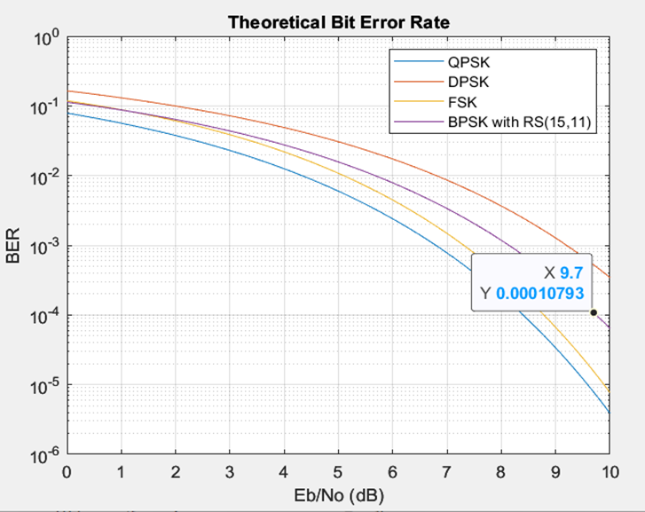
Required Eb/No for BPSK+ReedSolomon(15,11)
( assumed for link budget calculation target )

Slide 13
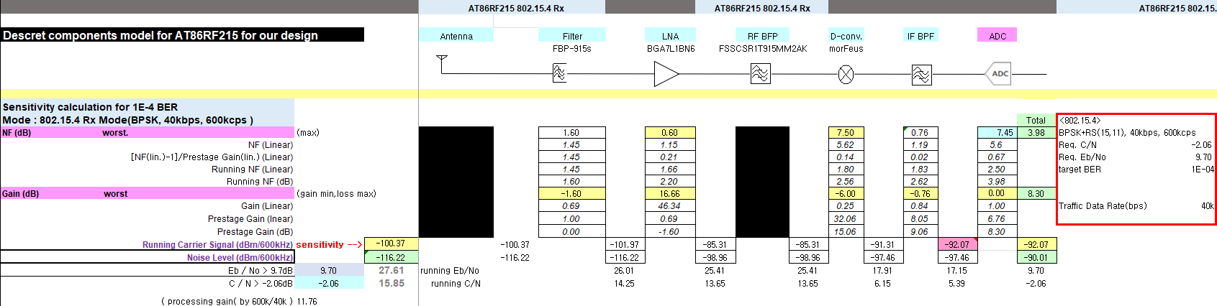
Discrete components model for AT86RF215 for our design

Slide 14
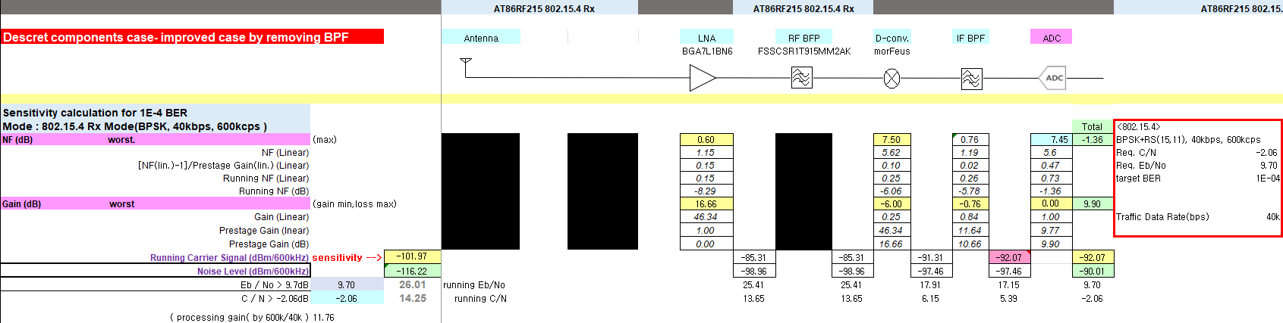
Discrete components case- improved by removing BPF

Slide 15
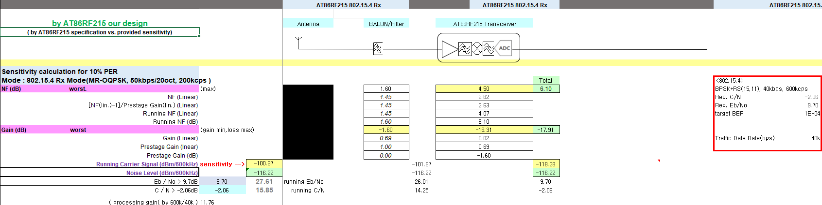
By AT86RF215 our design
( by AT86RF215 specification vs. provided sensitivity)

Slide 16
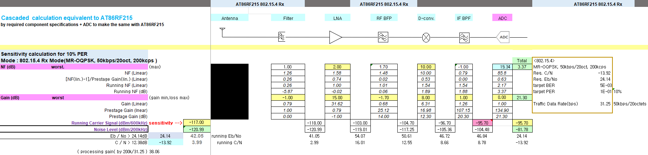
Cascaded calculation equivalent to AT86RF215
by required component specifications + ADC making the performance same to the AT86RF215 design

Slide 17
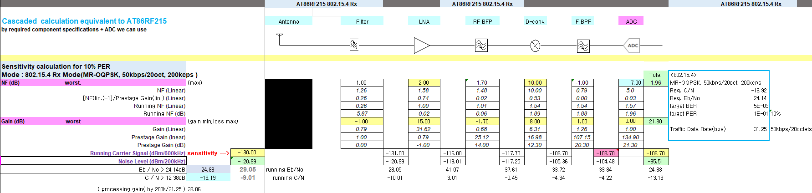
Cascaded calculation equivalent to AT86RF215
by required component specifications + ADC we can use

Slide 18
TX

Slide 19
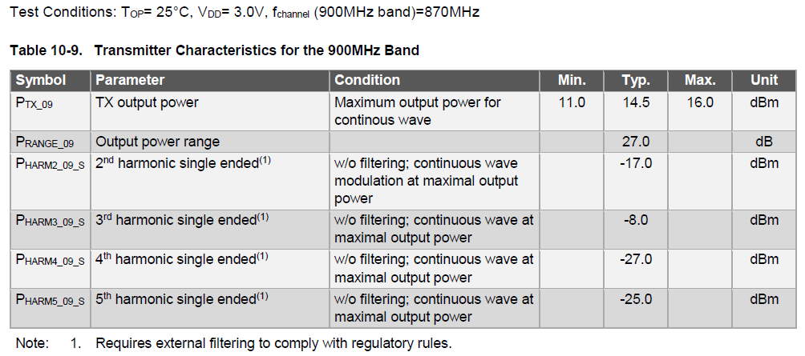
Transmitter

Slide 20
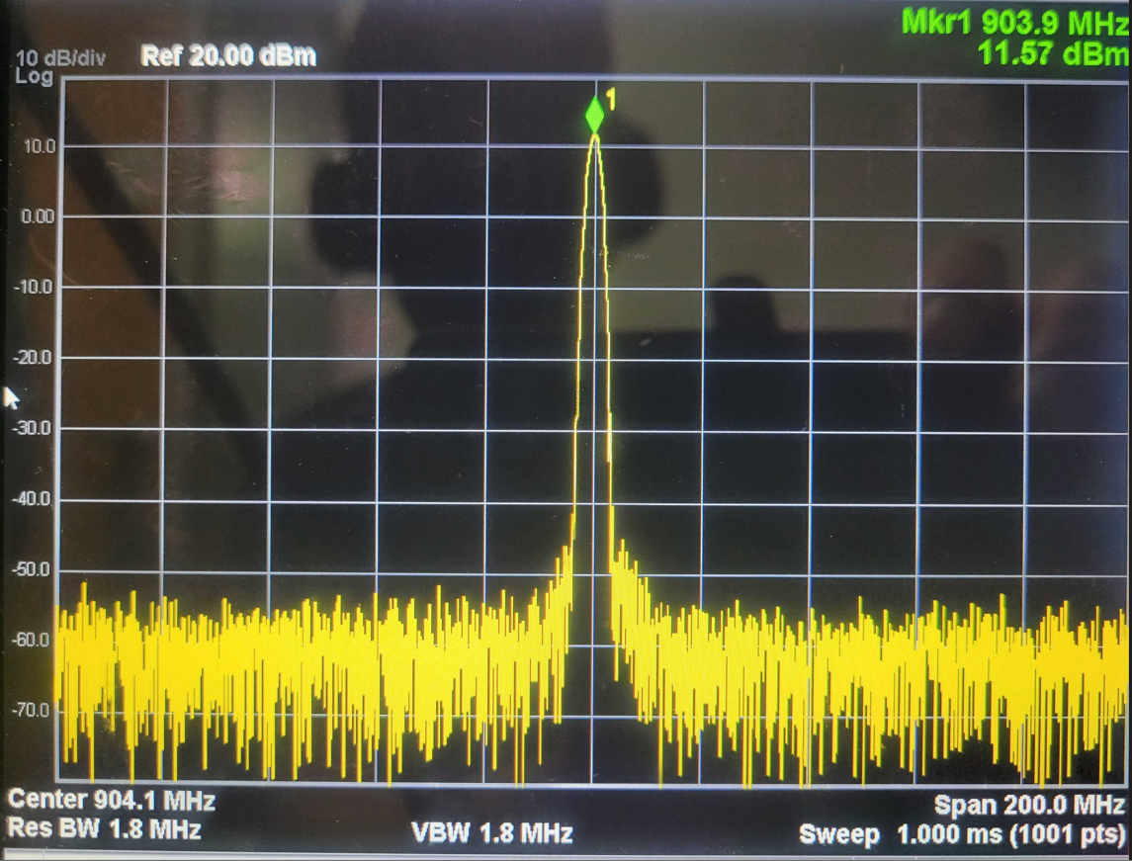

Slide 21
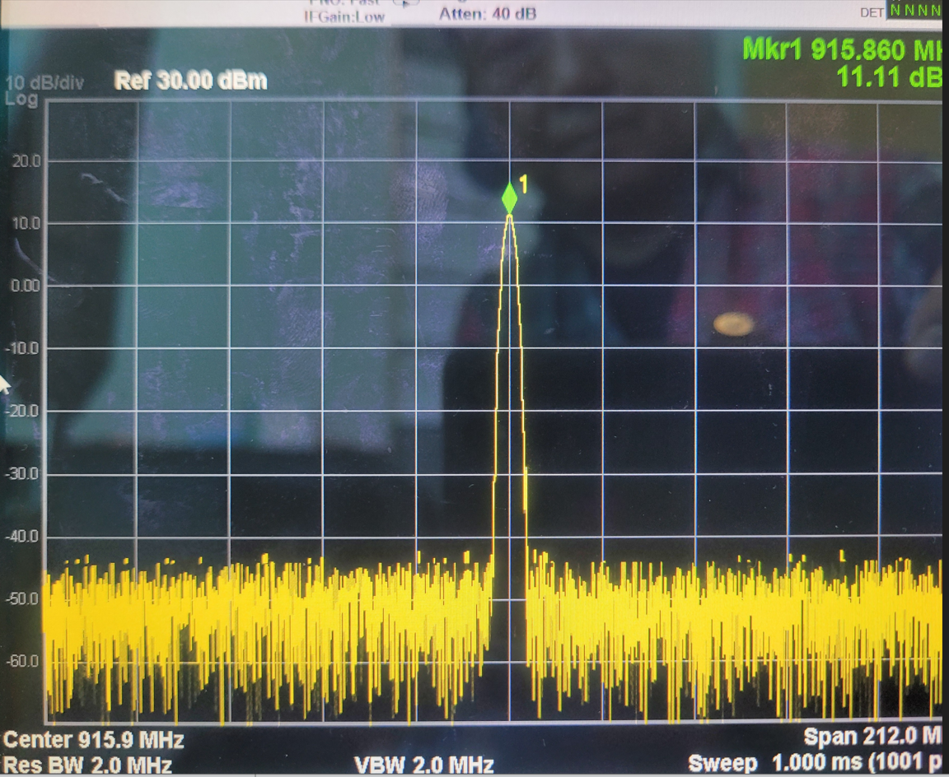

Slide 22
Link Margin Calculation for the Distance
Transmitter Parameters:
Output Power (PTx): 11 dBm (~10 mW)
Trace Loss (Lc): 0.3 dB
Antenna Gain (Gt): 2.14 dBi
Receiver Parameters:
Receiver Sensitivity (PSens): -100.37 dBm
Trace Loss (Lc): 0.3 dB
Antenna Gain (Gr): 2.14 dBi
System Noise Figure (NF): 6.1 dB
Path Loss:
Frequency (f): 915 MHz
Distance (d): 350 meters
Transmitting Antenna Height (ht): 2 meters
Receiving Antenna Height (hr): 2 meters
Environment Factor (L): 0 dB
Calculation:
Path Loss (PL) = 20*log10(4*pi*d*f/c) + 20*log10(ht) + 20*log10(hr) + L = 20*log10(4*pi*350*915*10^6/(3*10^8)) + 20*log10(2) + 20*log10(2) + 0 = 94.6 dB
Total Transmit Power (PTx_total) = PTx + Gt - Lc = 10 + 2.14 - 1 = 12.14 dBm
Free Space Loss (FSL) = 20*log10(4*pi*d*f/c) = 20*log10(4*pi*350*915*10^6/(3*10^8)) = 82.6 dB
Received Power (PRx) = PTx_total + Gt + Gr - PL - Lc - L = 12.14 + 2.14 + 2.14 - 94.6 - 0.3 - 6.1 = –84.6 dBm
Signal-to-Noise Ratio (SNR) = PRx - PSens - NF = -84.6 - 6.1- (-100.37) = 9.67 dB
Link Margin (LM) = SNR - System Requirement = 9.67 - (9.7) = -0.03 dB
Based on this calculation, the link margin is -0.03 dB for 350m with BER 1E-4, which indicates that the link should have good reliability with profer margin for ~350m

Slide 23
Simulink Channel model
: can be replaced by just path loss
For 802.15.4, the bandwidth is relatively small; hence, the channel will tend to be non frequency selective (i.e well approximated by a single scaled delta function).
So there really isn’t anything fancy to do here for simulated channel models. So a simple line of sight path loss model would suffice.
—Patrick

Slide 24
Future work
Link budget analysis : range vs. BER
RF Frontend + chanel model with Simulink for timing recovery simulation of baseband.
Rx/Tx chain integration and performance test.
: LVDS connector is required to thest I/Q radio mode vis LVDS interface.
Mixed signal part & FPGA interoperability test.
: FPGA is got delayed to be ready.
Troubleshooting for whole system operation.

Slide 25
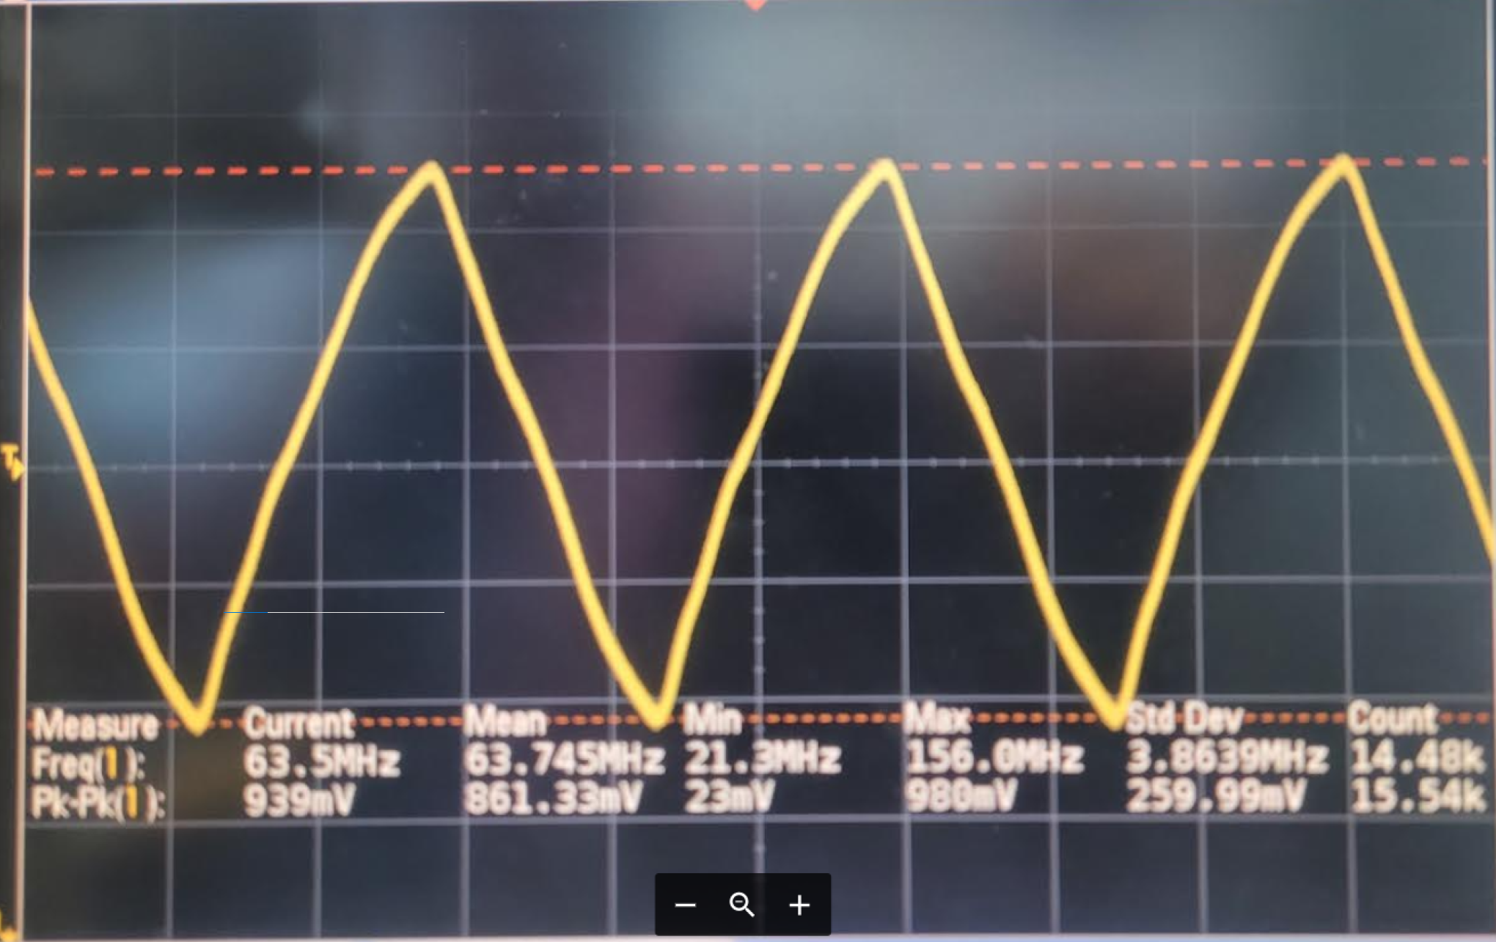
RXDCLK of LVDS interface

